Slide 1

Problems on Counting 2011

Slide 2
Reference
Data
Youtube
Code

Slide 3
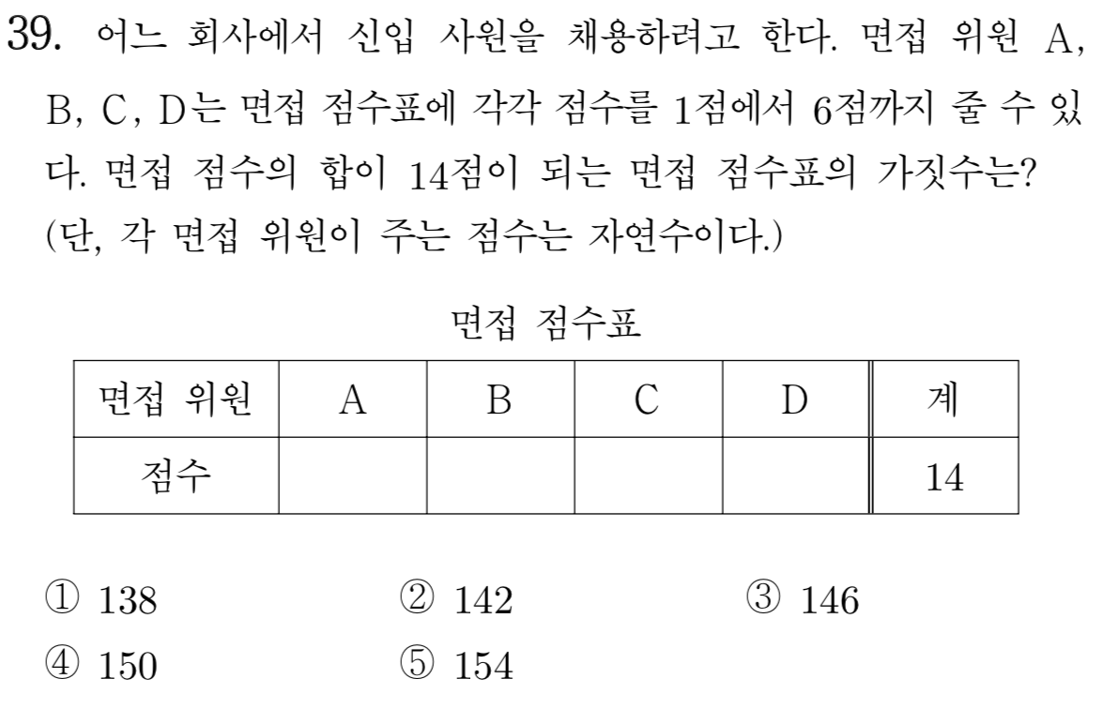
[2011]

Slide 4
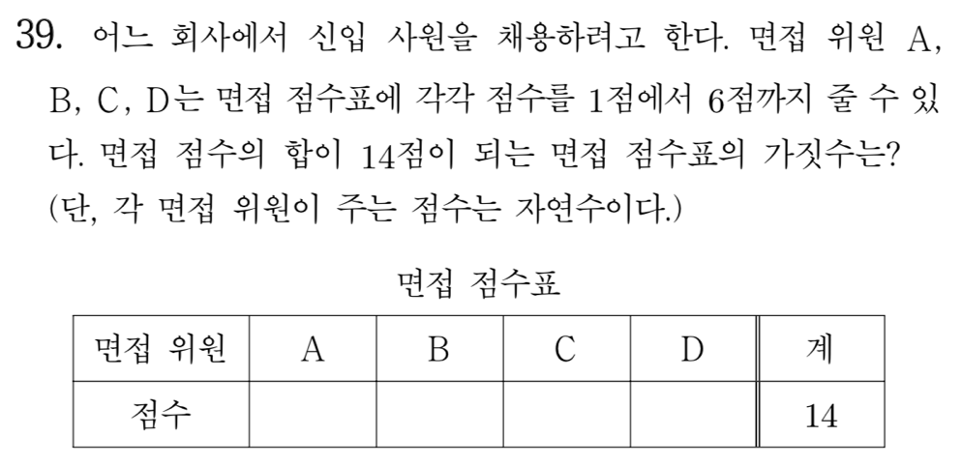

Slide 5
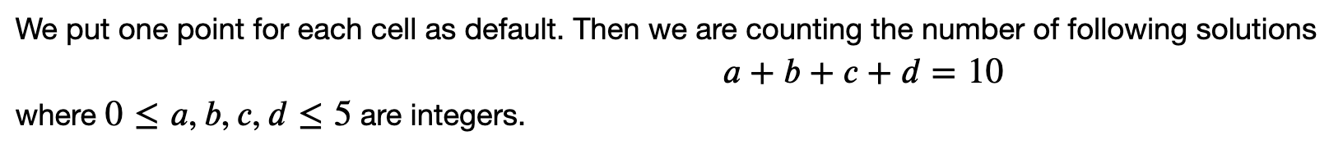

Slide 6
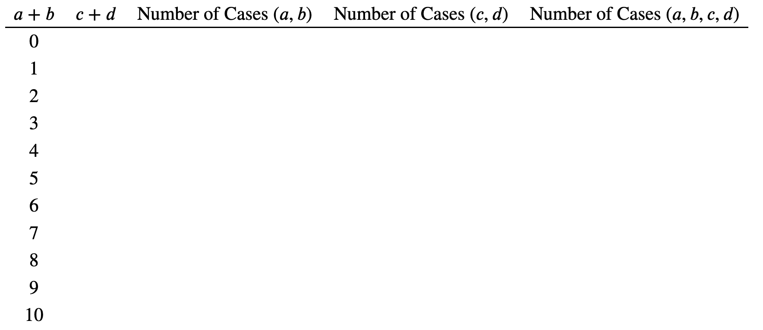

Slide 7
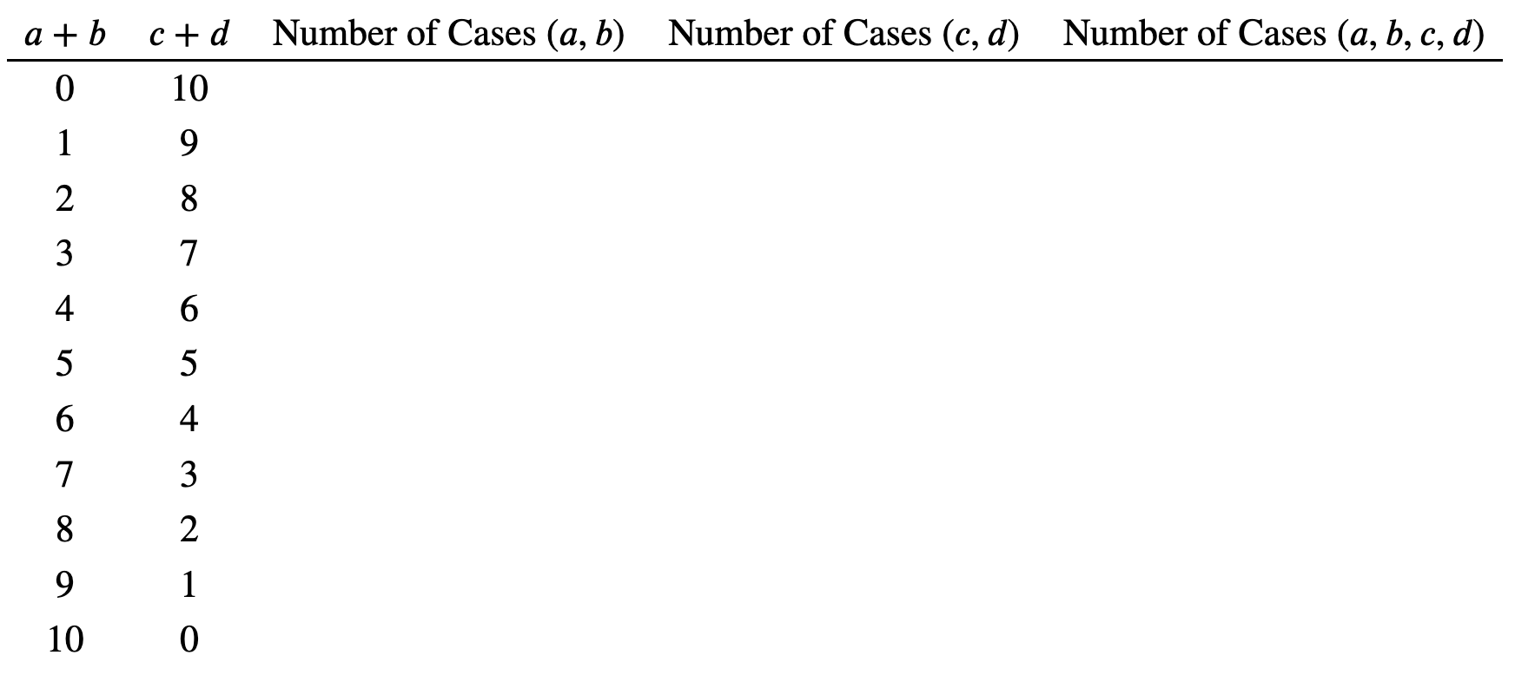

Slide 8

b=0, c=1, d=0, e=2

Slide 9
b=0, c=1, d=0, e=2

Slide 10
b=1, c=0, d=0, e=2

Slide 11
b=1, c=0, d=0, e=2

Slide 12
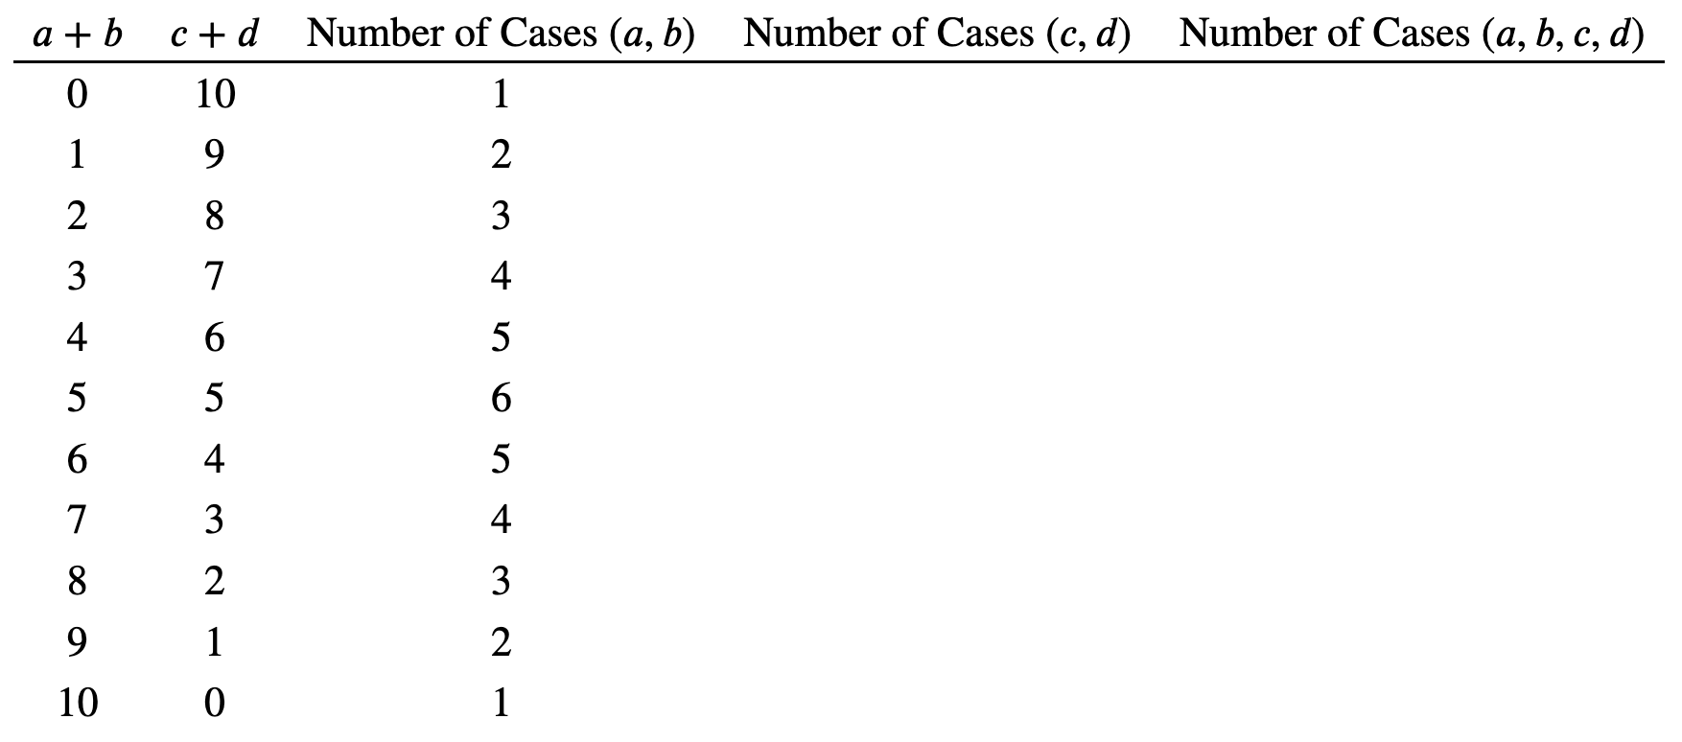

Slide 13
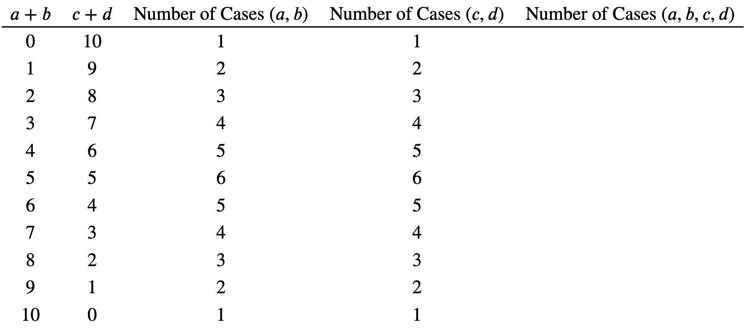

Slide 14
